Slide 1
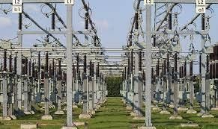
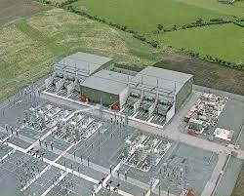
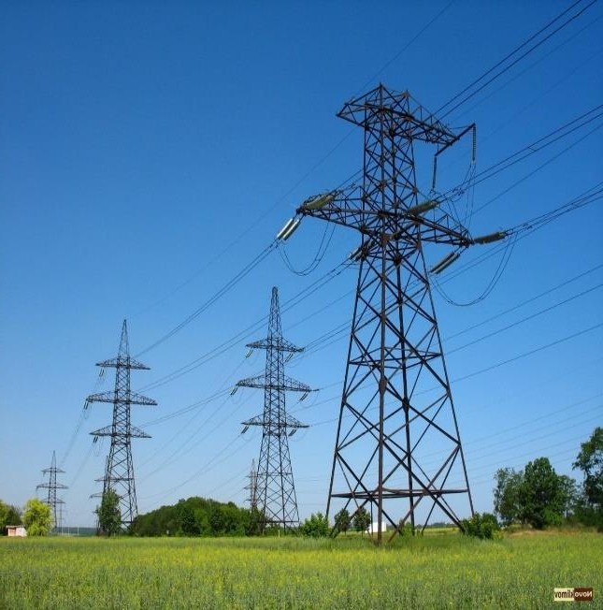
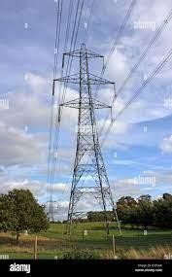
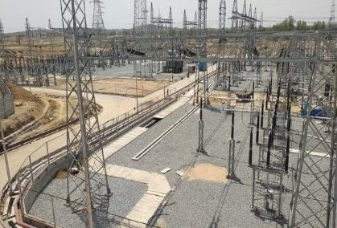
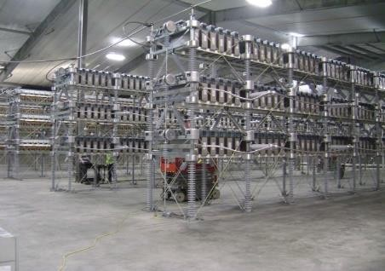
Caucasus Transmission Network I-III (Armenia-Georgia Transmission Line/Substations) Project, financed by KfW Bank
400/220 kV Substation in Ddmashen
HVDC BtB Converter Station
in Ayrum
400 kV OHL
500 kV OHL

Slide 2
Project Objective
▶Asynchronous power connection between Georgia and Armenia, thereby providing a reliable, flexible and mutually profitable cross-border energy exchange, as well as regional integration of power systems within South Caucasus countries - Georgia, Iran and Armenia.
▶Increasing the security level of energy system of Armenia and the quality of power supply reliability as well as expanded and stable economic development
▶Expansion of cross-border power trade and decrease of losses in power transmission network
▶Assisting in the efficient utilization of the two countries’ generating facilities and renewable energy resources, as well as protection of environment and climate
▶Connecting Armenia to the EU (ENTSO-E) network and introducing EU standards
http://www.hven.am/

Slide 3
Project Description
The Project shall be implemented with three subsequent stages (3x350 MW) with final capacity of 1050 MW. The first phase is being implemented with three lots.
Lot 1. Ddmashen Substation – 30 months
400/220 kV Ddmashen substation construction, including high voltage transmission line loops in/out for Noraduz, Gosh and Marash
Lot 2. Transmission Lines - 36 months
▶ Construction of one new 500 kV single circuit OHL from Georgian border up to 500 kV
Switchyard in Ayrum HVDC converter station (app. 7.6 km)
▶ Construction of one new 400kV double circuit OHL (one circuit strung) from 400 kV
Switchyard in Ayrum converter station up to 400 kV Switchyard in Ddmashen substation
(app. 96 km)
▶ Construction of 220 kV Alaverdi-Gardabani loop in OHL to new Ayrum substation (Ayrum- Alaverdi 220 kV OHL)
▶ Rehabilitation/replacements of 220 kV Lori single line OHL (app. 50km) and replacement of 110 kV Tumanyan 1 & 2 double circuit OHL (app 3km)
Լot 3. HVDC Converter station – 36-40 months
Construction of 350 MW BtB (VSC technology) HVDC Converter station in Ayrum.

Slide 4
Project Responsible Authority Ministry of Territorial Administration and Infrastructures of the RoA
Project Implementing Company
«High Voltage Electric Networks” Closed Joint Stock Company
Project Financers
▶ KfW Bank
▶ European Investment Bank
▶ European Union Neighborhood Investment Facility
http://www.hven.am/

Slide 5
Works Implemented A Pre-qualification process of General Contractors selection was performed. As a result of this process, the following companies were qualified:
▶Lot 1 - Siemens Aktiengesellshaft (Germany) and Efacec Engenharia e Sistemas, S.A.
(Portugal)
▶ Lot 2 - KEC International Limited (India) and Kalpataru Power Transmission limited
(India)
▶ Lot 3 - Siemens Aktiengesellshaft (Germany) and ABB Power Grids Sweden AB/Cobra
Instalaciones y Servicios, S.A. Consortium (Sweden/Spain)
The process of preparing the Tender Documents of General Contractors selection for all three lots was performed as well. As a result of this process the Tender Documents for the selection of General Contractors were submitted to KfW Bank for approval.
http://www.hven.am/

Slide 6
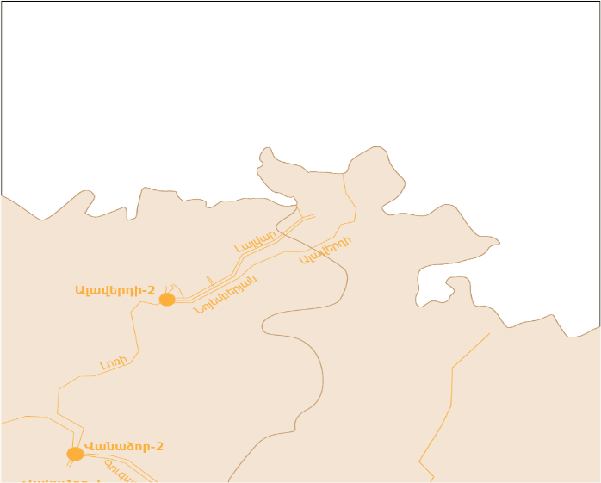
Ayrum S\S
Project final results
As a result of CTN project implementation by the construction of new OHLs, HVDC Converter station and Substations the quality of the services for cross-border power flows will be noticeably improved, the development of regional mutually beneficial cooperation in the field of energy will be significantly promoted, the capacity of Armenia-Georgia electricity exchange will reach up to 350 MW from the current 200 MW. During the next two stages, depending on the volume of electricity flows, it is planned to increase the capacity up to 1050 MW.
Eventually, the development of mutually profitable cooperation between the North-South /Russian Federation-Georgia-RA-IRI/ in the field of energy will be significantly promoted, as well as a precondition will be created for organizing parallel work with the power systems of CIS countries.
500 kV
Alaverdi-2
Ayrum S\S
Vanadzor-2
HVDC Converter station
Gyumri-2
Vanadzor-1
Ddmashen S\S
Ashnak
Charencavan-3
Kamo
Shahumyan-2
Zovuni
Haghtanak
Lichq
Marash
Ararat-2
Eghegnadzor
400 kV
Noravan S\S
Shinuhayr
Agarak Swithching point

Slide 7
Thank you
http://www.hven.am/

