Slide 1
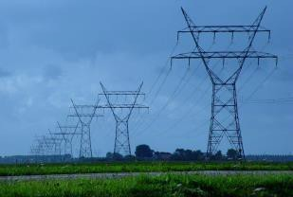
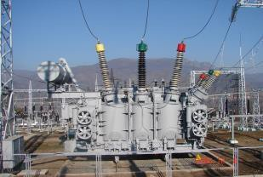
“Construction of Iran-Armenia 400kV Power Transmission Line and Related Substation” (400/220/20kV «Noravan»)» Project

Slide 2
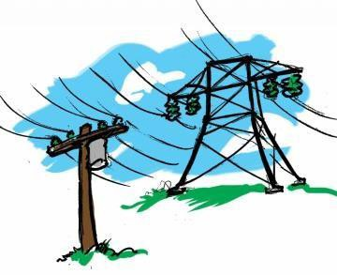
Project Main Data
▶ Loan amount– 107.9 mln euro
▶ Financing organization– Export Development Bank of Iran (85%) and «SUNIR International FZE» Company (15%)
▶ Loan amortization – 2024-2028
▶ Contractor – Iran Power and water Equipment & Services Export Company “Sunir”.
http://www.hven.am/

Slide 3
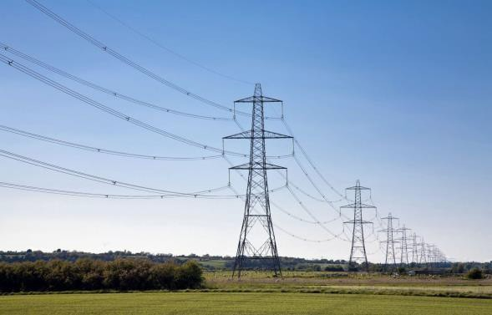
Project Objective
▶ Increase electric energy flows between Armenia and Iran from 350 MW to 1,200 MW.
▶ Increase the reliability and stability of the parallel operation of the energy systems of Armenia and Iran.
▶ Increase the safety level of the RA energy system by strengthening the North-South energy connection of the country.
▶ To fully use the capacity of Iran-Armenia gas pipeline within the framework of the " "Gas in exchange for electricity" project.
http://www.hven.am/

Slide 4
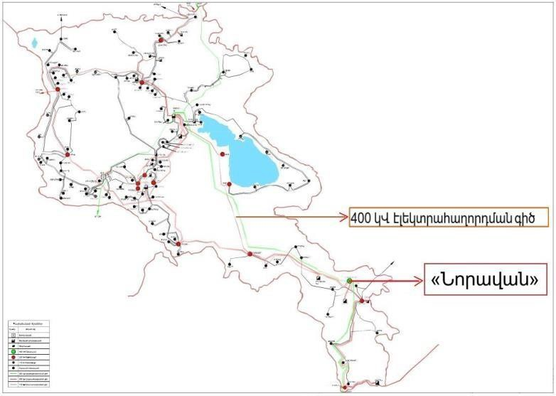
Project overview
▶ The length of the double-circuit overhead transmission line is about 268 km , the
number of towers is 711.
▶ The substation is located about 200 km from Yerevan, in the settlement of
Vaghatin, Syunik Marz, RA.
▶ It occupies an area of 12 hectares.
▶ The installed capacity in the substation is 2 x 200 MVA.

Slide 5
Expected outcome
After completion of the Project
▶ Will be increased electric energy flows between Armenia and Iran from 350 MW to 1,200 MW.
▶ Increase the reliability and stability of the parallel operation of the energy systems of Armenia and Iran.
▶ Increase the safety level of the RA energy system by strengthening the North-South energy connection of the country.
▶ To fully use the capacity of Iran-Armenia gas pipeline within the framework of the " "Gas in exchange for electricity" project.
▶ The works are foreseen to be completed by the end of 2023.
http://www.hven.am/

