Slide 1
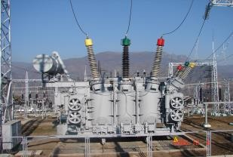
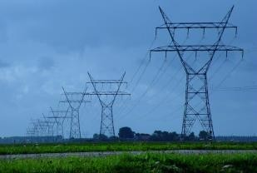
“Electricity Supply Reliability
Project - Additional financing” LoanProject
Reconstruction of “Vanadzor-1”, “ Charentsavan-3 ” “Zovuni” substations

Slide 2
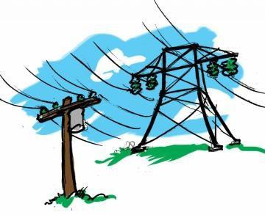
Project main data
▶ Financing Organization– International Bank of Reconstruction and Development (IBRD)
▶ Consulting organization– decon international GmbH and JV
Consulectra Unternehmensberatung GmbH, “Aram Karapetyan” IE
▶ Contractors – Kaskad Energo LLC, Xian Electric Engineering Co.
Ltd, Efacec Engenharia e Sistemas S.A., China National Electric
Engineering Co Ltd
http://www.hven.am/

Slide 3
Project Objective
▶ Increase the reliability and capacity of power transmission network, as well as
power system operation efficiency, reduce substation operating costs
▶ In order to achieve the goals set by the Electricity Supply Reliability Project
Additional Financing Project, reconstruct "Charentsavan-3“, "Vanadzor-1" and
“Zovuni” substations. As a result of substation reconstruction, it is expected to
minimize the number of emergency outages due to equipment failure, reduce
operating costs
▶ In order to improve facilities maintenance purchase specialized
machinery and vehicles
http://www.hven.am/

Slide 4
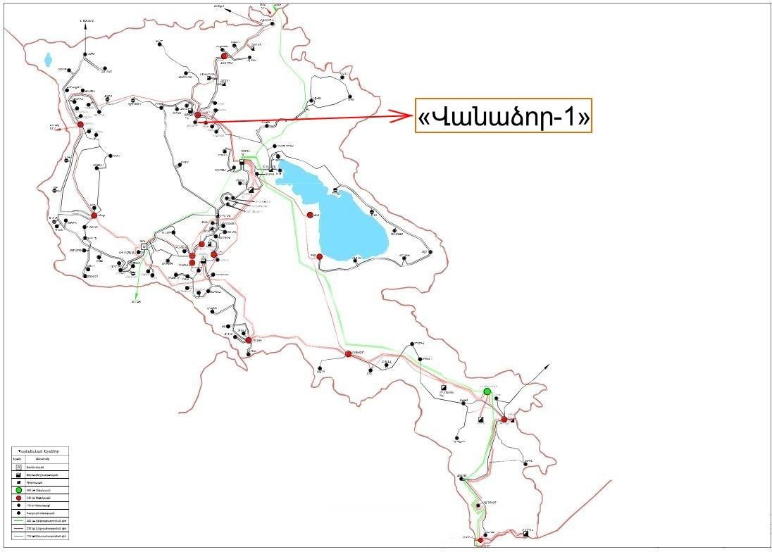
Reconstruction110/10/6 kV “Vanadzor-1" substation
▶ Was built in 1933, located 37 km from Yerevan.
▶ Occupies an area of 3,6 hectares
▶ Contract price՝ 4,083,875,43 USD dollar
Scheduled works
▶ Reconstruction of 110kV OSY
▶ Repairment of two power transformers
▶ Replacement of 6 kV CSG
▶ Overhaul of the Control building and replacement of
equipment
▶ Installation of SCADA system
http://www.hven.am/

Slide 5
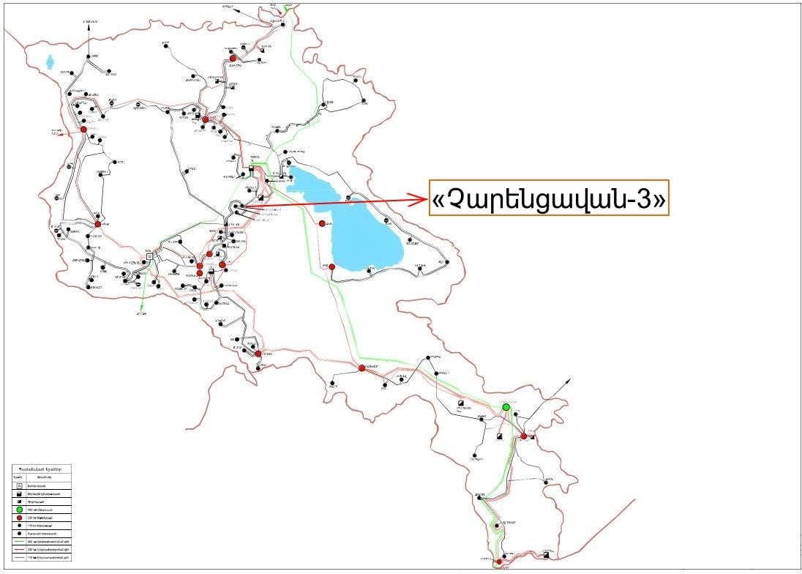
Reconstruction of 110/10kV “Charentsavan-3" substation
▶ Was built in 1985 located 37km from Yerevan
▶ Occupies an area of 4,4 hectares
▶ Contract price: 2,521,639․29 USD dollars, 2,946,265․35 euro, 658,639,773,45 AMD
Scheduled works
▶ Replacement of 110kV and 6kV OSY
▶ Replacement of two 110kV power transformers
▶ Replacement of 110/10kV autotransformers
▶ Replacement of 10kV CSG equipment
▶ Construction of new Control building and replacement of
equipment
▶ Installation of SCADA system
Completion of works is foreseen in 2023.
http://www.hven.am/

Slide 6
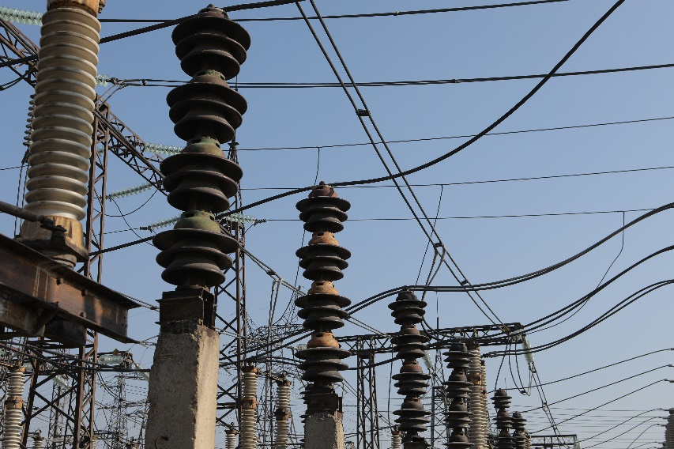
Reconstruction of 220/110/10 kV “Zovuni" substation
▶ Was built in 1975 , Located in Yerevan
▶ Occupies an area of about 3,2 hectares
▶ Contract price: 7,946,093,08 USD dollars
Scheduled works
▶ Partial replacement of 220, 110, 6 kV OSY
▶ Reconstruction of 220/110/10 kV autotransformers
▶ Repairment of two power transformers
▶ Replacement of 6 kV CSG equipment
▶ Overhaul of Control building and replacement of equipment
▶ Installation of SCADA system
Completion of works is foreseen in 2024.
http://www.hven.am/

Slide 7
Expected Outcome
In the result of Project implementation
▶ Reliability and capacity of power transmission network will be increased
▶ Operational effectiveness of Energy system will be increased
▶ Operational costs of substations will be reduced
▶ Emergency outages due to equipment failure will be reduced
http://www.hven.am/

