Slide 1
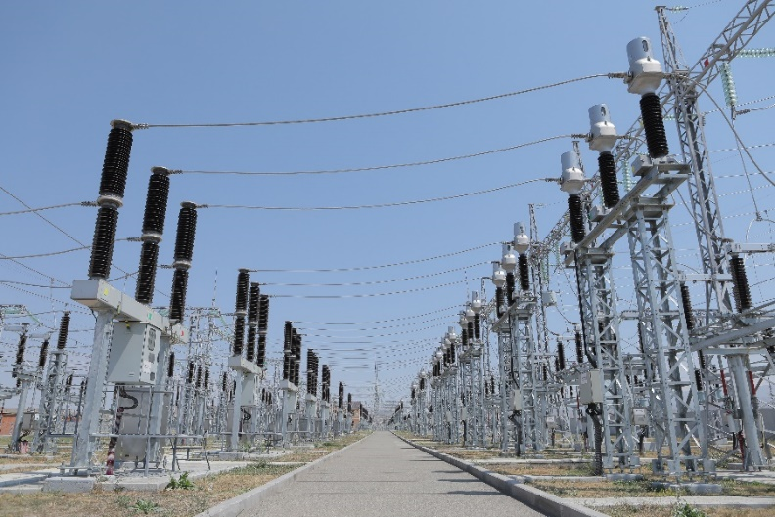
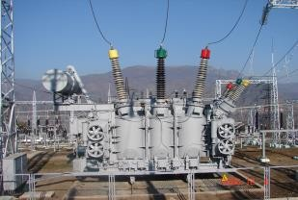
“ Electricity Transmission Network Improvement’’ Loan Project Reconstruction of 220/110/6 kV «Ararat-2» substation

Slide 2
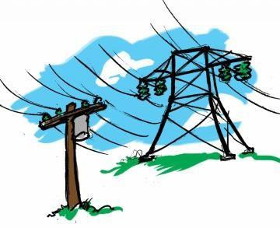
Project Main Data
▶ Contract price– 13,138,984․8 USD dollar
▶ Financing organization–International Bank of Reconstruction and Development (IBRD)
▶ General Contractor—“Kaskad Energo” LLC
▶ The substation is under operation from 1975, located in the Ararat region, occupies an area
of 4.6 ha
Works to be done
▶ Reconstruction of 220, 110 kV OSYs and their partial replacement
▶ Reconstruction of 6kV CSG building, replacement of 6kV cells
▶ Replacement of two autotransformers and two boost transformers
▶ Reconstruction of control and warehouse buildings
▶ Modernization and digitization of RPA equipment and SCADA system
▶ Landscaping of substation area, reconstruction of fence, installation of video surveillance
system
Completion of works is foreseen in 2024.
http://www.hven.am/

Slide 3
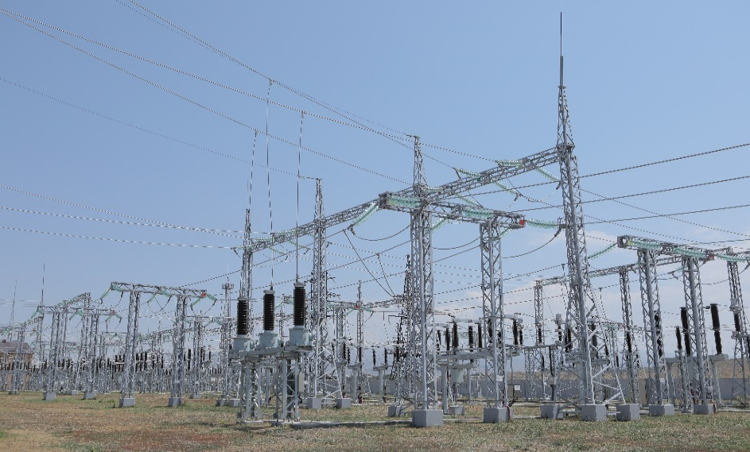
Project Objective
Increase the reliability and safety of the power transmission network, reduce the number of emergency outages, increase the reliability of uninterrupted electricity supply to consumers, reduce the costs of substation operation as well.
http://www.hven.am/

Slide 4
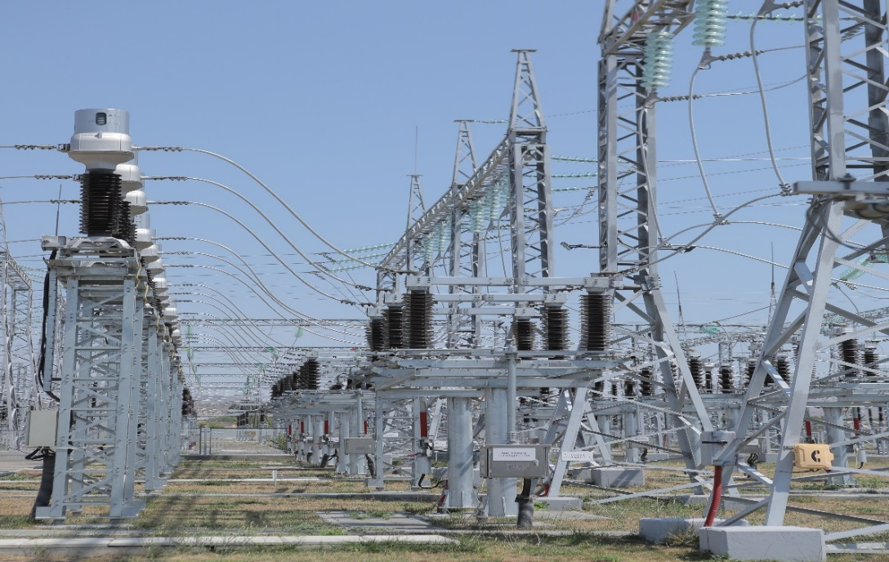
Expected outcome
As a result of the Project implementation, the reliability of the power transmission network will be increased and the number of emergency outages will be reduced, the reliability of uninterrupted electricity supply to consumers will be increased, and the operating costs of substations will be reduced.
http://www.hven.am/

