Slide 1
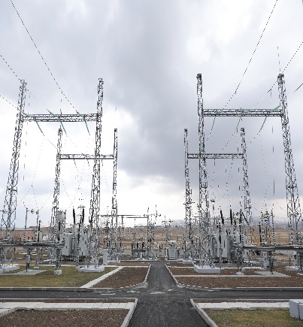
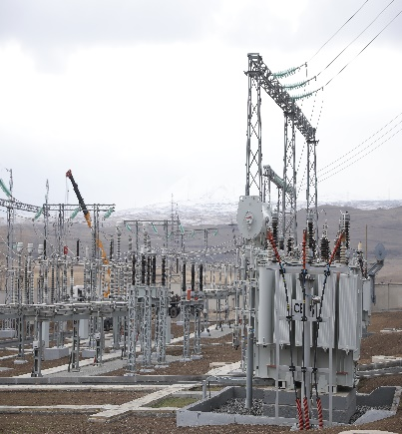
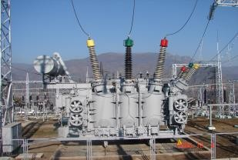
“High Voltage Electric Networks” CJSC Projects implemented with own funds Rehabilitation of “Lichq”, “Agarak-2”, “Shinuhayr” substation

Slide 2
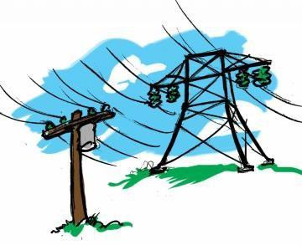
Purpose of the Project
▶ Improve the efficiency of Armenia's energy system
▶ Increase the efficiency of the internal power grid
▶ Minimize power transmission losses
▶ Increase the reliability of electricity supply to consumers in the region
▶ Support the sustainable economic development of the republic
▶ Promote reliable, flexible and mutually beneficial cross-border exchanges of electricity between the energy systems of Armenia and Iran
http://www.hven.am/

Slide 3
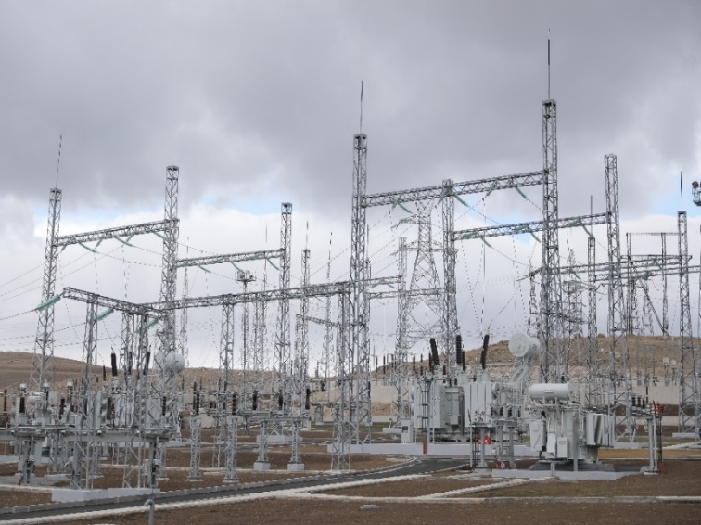
220/110/35 kV “Lichq” substation
▶ Contract price – USD 10,629,120․0
▶ Financing company – “High Voltage Electrical Networks” CJSC
▶ Contractor - “Kaskad Energo” LLC
The rehabilitation of “Litchq” 220/110/35 substation is planned to be completed during the first quarter of 2023
Implemented works
▶ new 2 X 125MWA Autotransformers were installed
▶ 2 X 35/35 kV new boost transformers
▶ 220,110,35kV new equipment
▶ 35kV new switchgear building was constructed
▶ relay protection and automation systems were replace and digitized
▶ The area was improved, the fence was reconstructed, video surveillance and security systems were installed
Against the planned 10,629,120.0 US dollars, the work of 10,308,800 US dollars (97 percent) was actually carried
out.
http://www.hven.am/

Slide 4
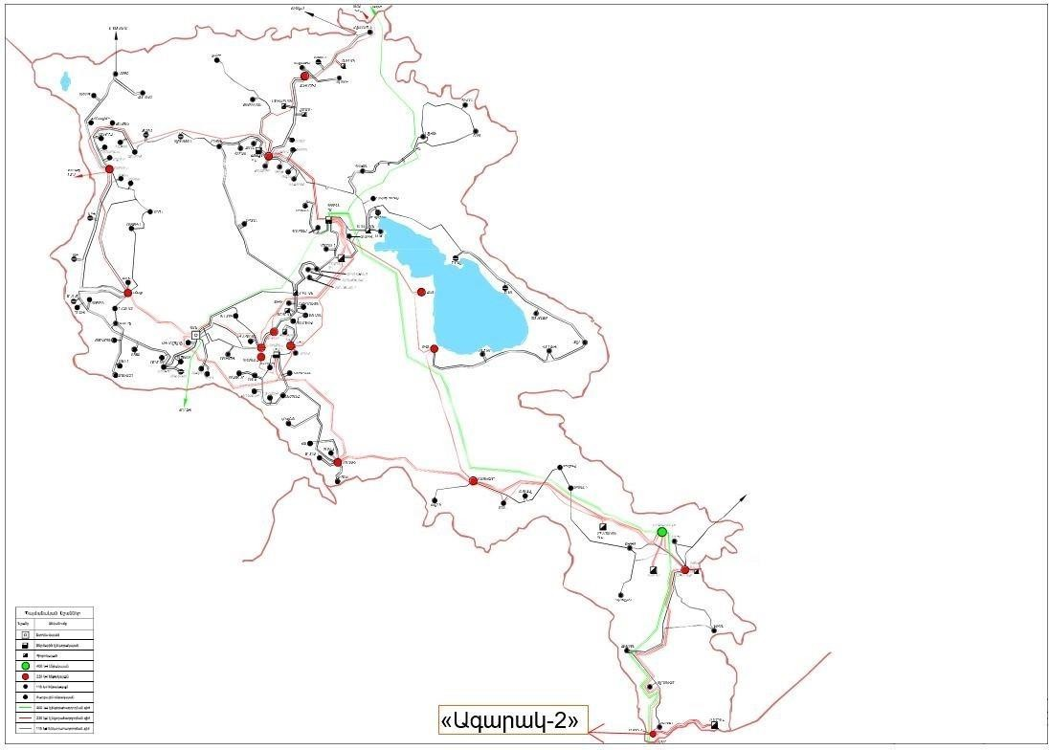
220/110/6 kV “Agarak-2” substation ▶ Contract price - 1,135,500․0 USD dollars ▶ Financing company – “High Voltage Electrical Networks” CJSC ▶ Contractor - “Kaskad Energo” LLC
It is located 385 km from Yerevan, in Karchevan, Syunik Marz, RA, and occupies an area of 3.8 ha.
In 2002 it was built and operated as “Agarak-2 220kV” switching point.
Scheduled works
▶ ““Agarak-2 220kV” ” switching point should be reconstructed as
220/110/6 kV “Agarak-2” substation
▶ 220kV switchyard should be reconstructed
▶ 110kV switchyard and 6kV switchgear should be constructed.
The works have been implemented since October 2022.
The completion of the works is planned to be in 2023.
http://www.hven.am/

Slide 5
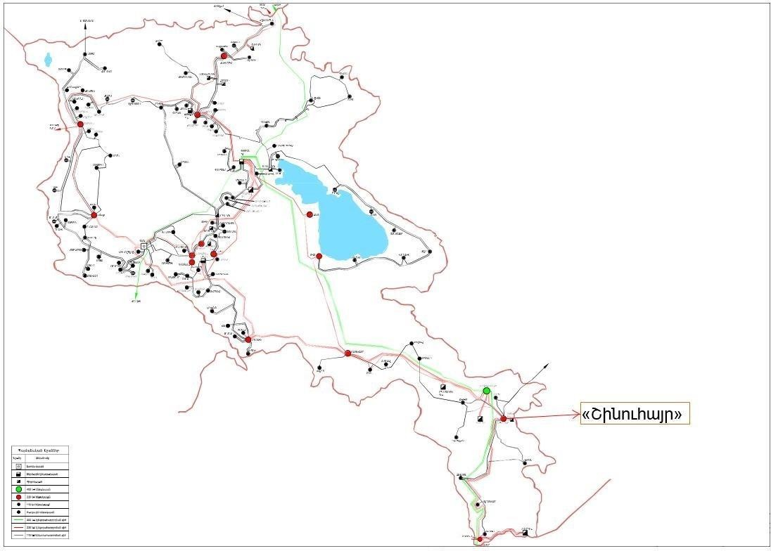
220/110/35/10 /6/ kV “Shinuhayr” substation
▶ Contract price – USD 5,255,000․0
▶ Financing company – “High Voltage Electrical Networks” CJSC
▶ Contractor - “Kaskad Energo” LLC
It was built in 1961 and is located at a distance of 235 km from Yerevan, in Shinuhair, Syunik Marz of the Republic of Armenia. It occupies an area of 6.6 ha.
Scheduled works
▶ Change of the diagram of 220kV switchyard making it I, II and bypass busbar systems
▶ Autotransformers and transformers will be rehabilitated
▶ All the 220kV, 110kV, 35kV, 10 /6/kV equipment, relay protection and automation equipment should be replaced. The completion of the works is planned to be in January 2024.
http://www.hven.am/

Slide 6
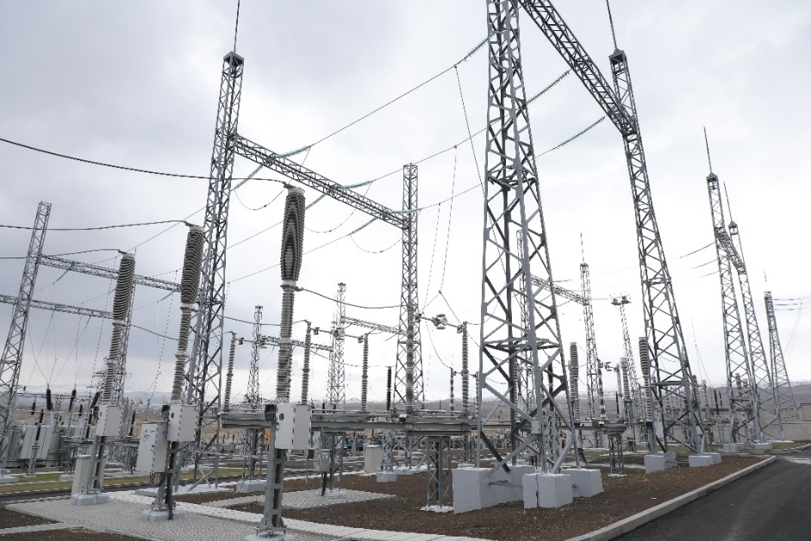
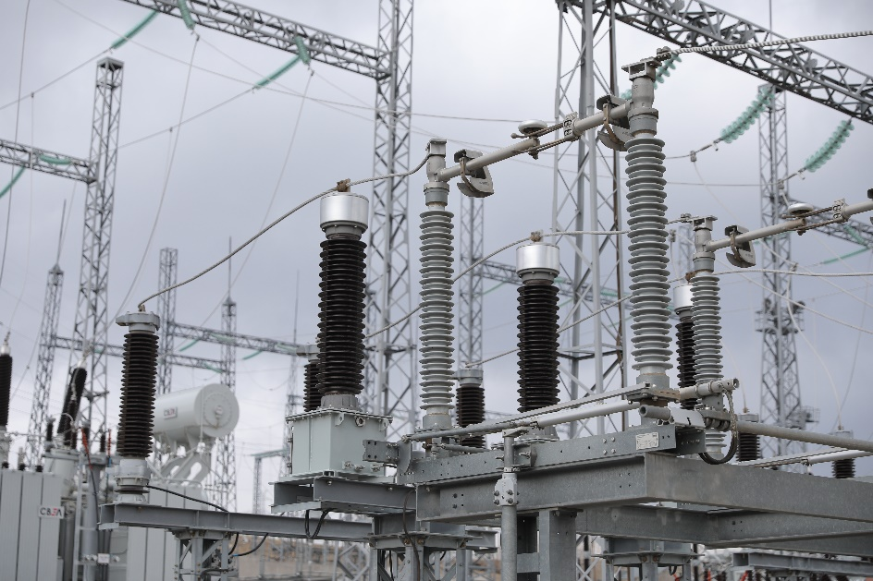
Expected outcome
▶ As a result of the project implementation, the efficiency of the power system of Armenia will be improved, power transmission losses will be minimized, the efficiency of the internal power transmission network and the reliability of power supply to consumers in the region will increase.
▶ The project will promote reliable, flexible and mutually beneficial cross-border exchanges of electricity between Armenia and Iran.

Slide 7
Projects to be Implemented by “High Voltage Electric Networks” CJSC in the Near Future
It is foreseen to carry out rehabilitation of three substations with loan facilities /about
USD 40mln
▶ 220/110/10 kV “Shahumyan-2” ▶ 220/110/10kV “Marash” ▶ 220/110/35 kV “Yeghegnadzor”
http://www.hven.am/

Slide 8
The Purpose of the Projects to be Implemented in the Near Future
The substations to be reconstructed are crucial from the point of view of
safe and reliable electricity supply of the RA energy system
For extending their service life and for their operation, it is necessary to:
▶ replace the worn and obsolete equipment with new ones
▶ replace the old relay protection equipment with microprocessor relays
▶ implement rehabilitation works of dilapidated reinforced concrete
structures, trenches, foundations, earthing loops
The necessity of the rehabilitation works is conditioned by the following
factors:
▶ the high degree of depreciation of equipment that has been in
operation for more than 40 years creates great risks for ensuring the
reliability of the power supply.
▶ the regulated operation of the equipment is a serious problem, as the
mentioned spare parts have been out of production for a long time
▶ the relay protection and automation devices which are in operation are
worn out, they do not have the functions typical of the necessary
modern microprocessor devices.
▶ reinforced concrete structures have been in operation for 40 years
▶ cable trenches are in poor condition, they do not provide waterproofing
of the cables, which leads to the breakdown of the insulating layer and
the occurrence of accidents

